Slide 1

MINESWEEPER GAME
GAME OR NO GAME?
ZHOU FANG
PRIYANKA MUTTARAJU

Slide 2
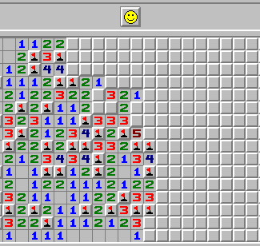
Project Introduction Goal of the Project Tools used Code Output
NOTE:
To change images on this slide, select a picture and delete it. Then click the Insert Picture icon
in the placeholder to insert your own image.
This Photo by Unknown Author is licensed under CC BY-SA

Slide 3
MINESWEEPER PROJECT
A classis 2-D list
Tools: Python 3 and Tkinter.
Goal: To uncover all the tiles that do not contain mines without being blown up.
Three levels in the game
Beginner (9x9 with 10 mines)
Intermediate (16x16 with 40 mines)
Advanced (30x16 with 99 mines)
Random integer/probability generator : Represents mines

Slide 4
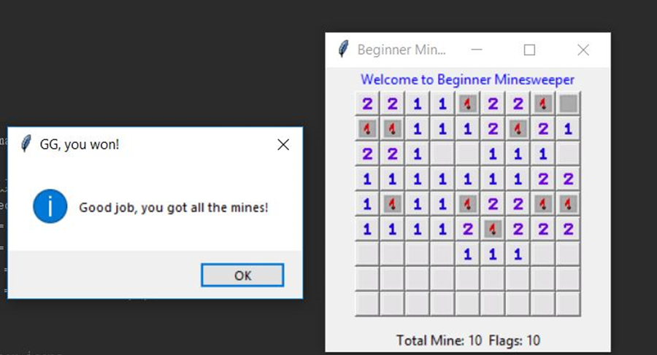
BEGINNER LEVEL – 9 x 9 grid

Slide 5
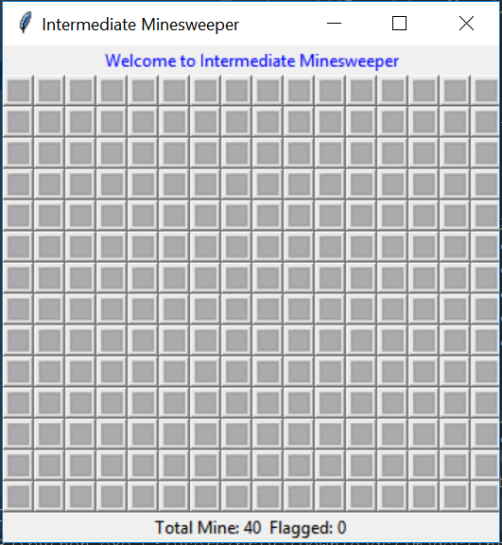
Intermediate Level – 16 x 16 grid

Slide 6
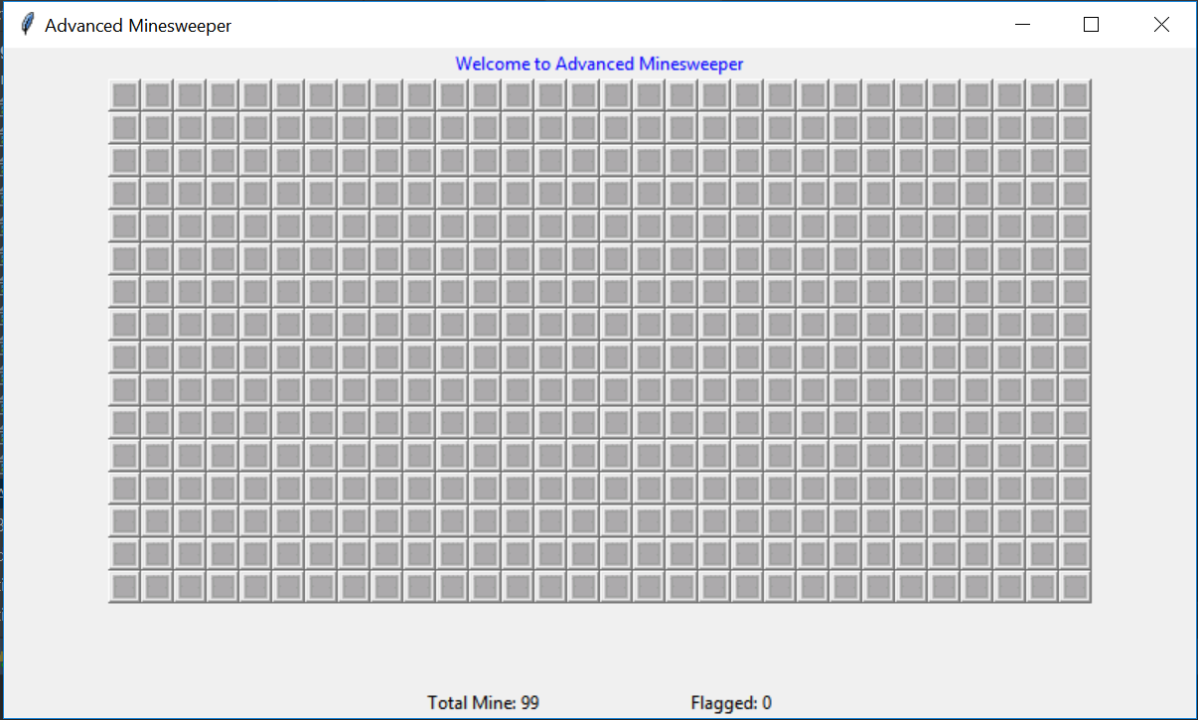
Advanced Level – 30 x 16 grid

Slide 7
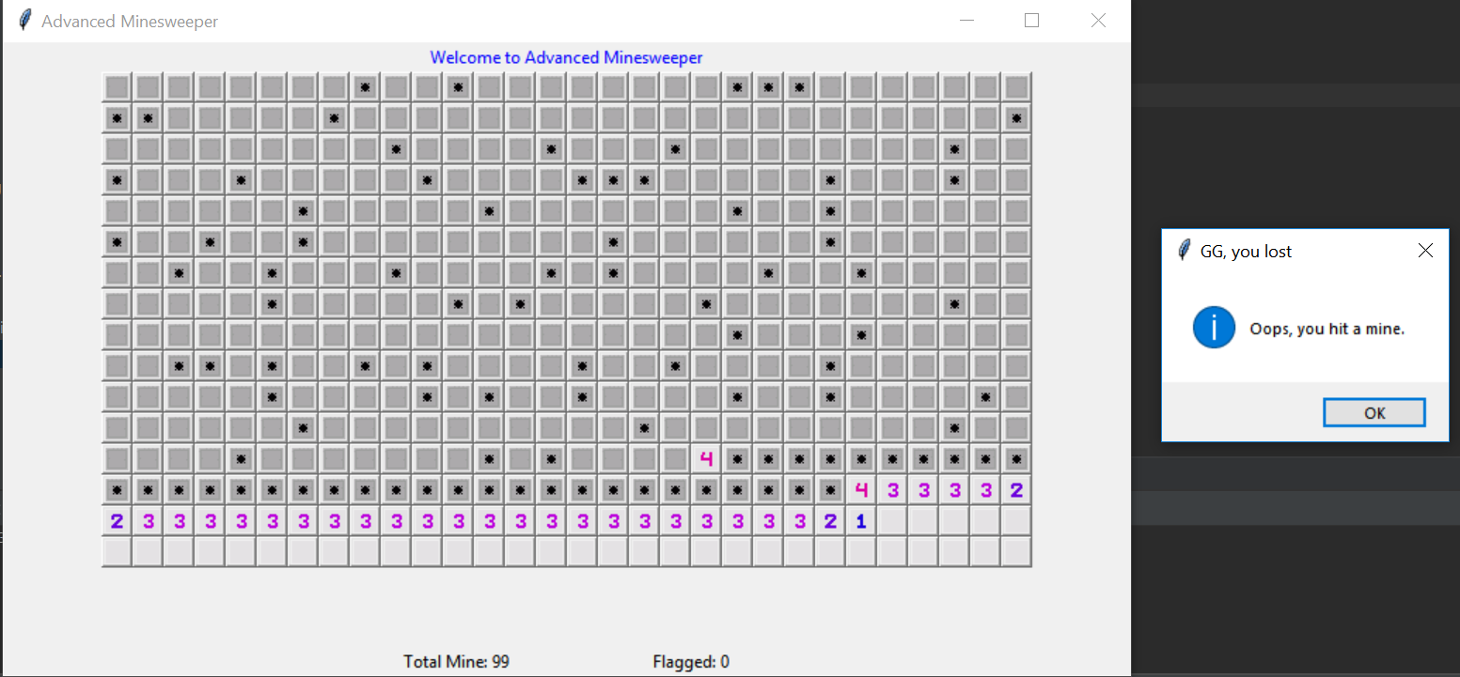
Advanced Level: Output

